Slide 1
Name : Jakirul Islam
Id : 193002101
Department of CSE
Topic name : electricity and magnetism

Slide 2
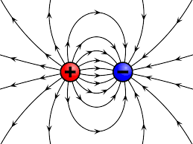
Electric field: the space surrounding an electric charge within which it is capable of exerting a force on another electric charge is called electric field.

Slide 3
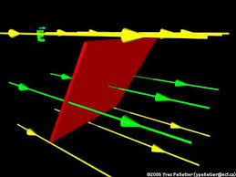
Electreic flux: The total number of electric field lines passing given area in a unit time is defined as the electric flux. Similar to the example above, if the plane is normal to the flow of the electric field, the total flux is given as: ϕp=EA When the same plane is tilted at an angle Ɵ, the projected area is given as AcosƟ and the total flux through this surface is given a
ϕ=EAcosΘ

Slide 4

Thanks

